Slide 1


Group 14: Mancala Logic Model
Alan Teng, Amy Brons, Dan Munteanu, Kate EDgar

Slide 2
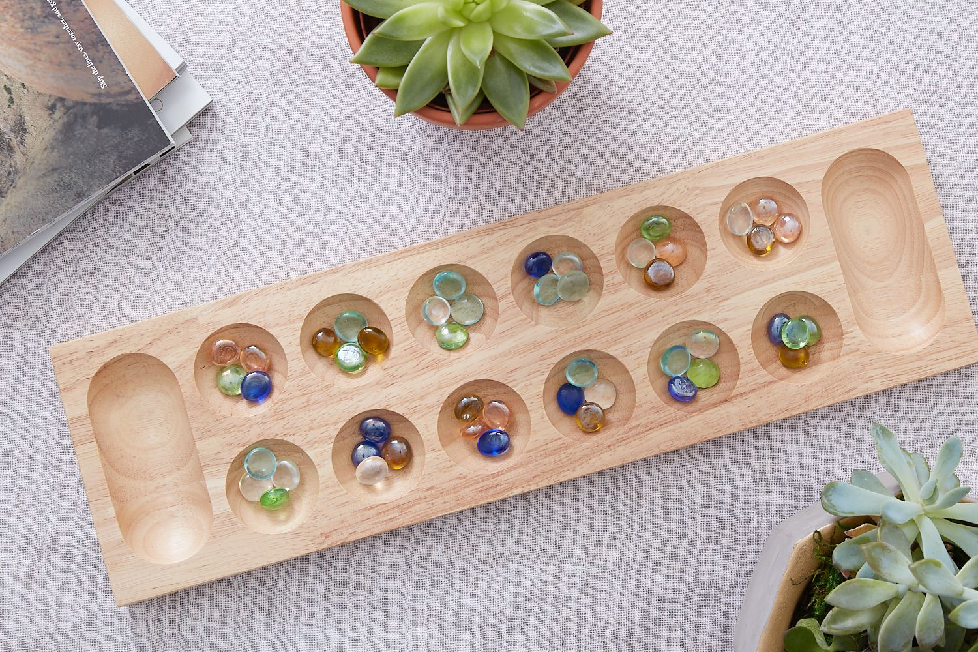
Summary
For this modeling project, we have decided to break down the game Mancala. This game is a two-player, turn-based strategy game where opponents attempt to gather as many stone as they can. The game begins with a certain number of seeds at each pocket it and players can only move the seeds on their side of the board. As it progresses, players will have the opportunity to secure the seeds in their own store. The goal of the game is to have the most seeds stored.
Image from: https://www.thesprucecrafts.com/mancala-411837

Slide 3
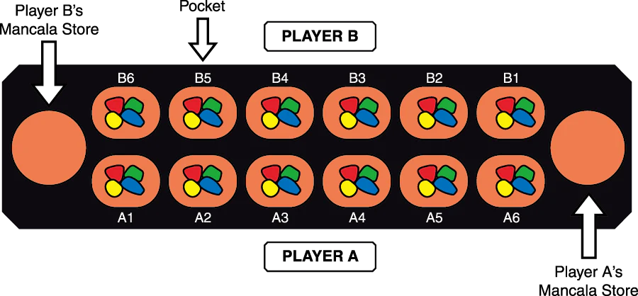
Our model
Since Mancala is quite complex, we've decided to model a simplified, single step version. The player will select a pocket and the program will appropriately distribute the seeds throughout the board and determine if the player goes again or if it is the opponent's turn.
Image from: https://www.ymimports.com/pages/how-to-play-mancala

Slide 4
Propositions
Starting position
X_{i,j}: True if the selected pocket is on the player's side
Y_{i,j}: True if there are seeds in the selected pocket
Collecting seeds
C: True if the player collects the seeds from the opposing pocket
Dropping seeds
W: True if the current seed is in the player's store, False if the current seed is in the opponent's store
P: True if the current seed is the final seed
G: True if the player gets another turn
D: True if the seed can be dropped

Slide 5
Constraints
The starting pocket must be on the player's side and have seeds in it
(X_{i,j} ∧ Y_{i,j})
If the last seed lands on an empty pocket, then the player collects the seeds in the parallel pocket
((X_{i,j} ∧ ¬Y) → C)
A seed can only be placed in a pocket or the player's store
W ∨ D
Seeds can't be dropped in the opponent's store
¬W → ¬D
If the final seed lands in the player's store, they get another turn
G →(P∧W)

Slide 6
End

